Slide 1
ICB Annual General Meeting 2024/25
Dr Jane Halpin, Chief Executive
Rt Hon Paul Burstow, Chair
Jonathan Wilson, Chief Finance Officer
The meeting will begin shortly
Notes:
Slide 1 – Welcome slide

Slide 2
Agenda for today
Welcome …......................... Rt Hon Paul Burstow, Chair
Reflecting on 2024/25 ….... Dr Jane Halpin, Chief Executive
Looking ahead …................ Dr Jane Halpin, Chief Executive
Financial update …............. Jonathan Wilson, Chief Finance Officer
Closing Remarks …............ Rt Hon Paul Burstow, Chair (10.25)
Close …................................ 10:30am
Notes:
9.30-9.35am – Paul Burstow
Slide 2 – agenda
Welcome everyone, to Hertfordshire and West Essex Integrated Care Board’s Annual General Meeting for the financial year 2024-25.
Thank you for joining us today.
We are recording this meeting so those who could not join us today can watch it back. If you do not want to be filmed, please do keep your cameras turned off. We will be uploading a copy of these slides to our website in the coming days so you can go back to review them if you wish.
All attendees are currently on mute – this is to help our speakers share information without background interruptions.
During our AGM today we will hear from ICB Chief Executive Dr Jane Halpin, who will reflect on the achievements and challenges of the last year, before a brief look forward to the future, with new ICBs due to be established during 2025/26.
Our Chief Finance Officer, Jonathan Wilson, will then talk us through the financial report, after which we will draw the AGM to a close. I’m now going to hand you over to Jane.

Slide 3
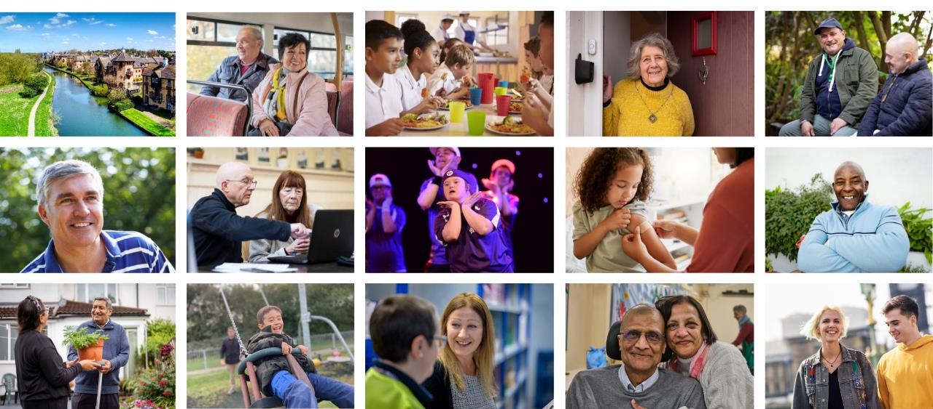
About Hertfordshire and west Essex
1.6
We plan and pay for health services
million people
£3.9
We monitor quality and improve services
billion budget
Notes:
Jane Halpin
Slide 3 – About us
Hello, I'm Dr Jane Halpin and I have had the privilege of leading the ICB since its inception in 2022. As some of you will be aware, my time as CEO is now drawing to a close, and I am preparing to hand over to a new leadership team, who will shortly take on strategic responsibility for the ICB in the months ahead.
New larger ICBs are being established across the East of England region, which will see the separation of Hertfordshire and West Essex as a statutory organisation – and we’ll touch on that briefly later.
But before looking forward, I want to take this opportunity to reflect on the ICB's work to improve the health and wellbeing of our population over the course of the year, because there's a lot to be proud of.
For those who may not know, the budget allocated to our ICB by the government is used to pay for the majority of health services that our 1.6 million residents rely on. £3.9m is a lot of money – but demand for treatments, services and care is higher than ever before. It is our responsibility to squeeze as much value as possible out of our annual allocation. We are also responsible for:
making sure that health services work well and are good quality
joining up health and care services
improving health and wellbeing
reducing health inequalities
and delivering an ambitious integrated care strategy across the area.

Slide 4
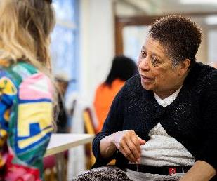
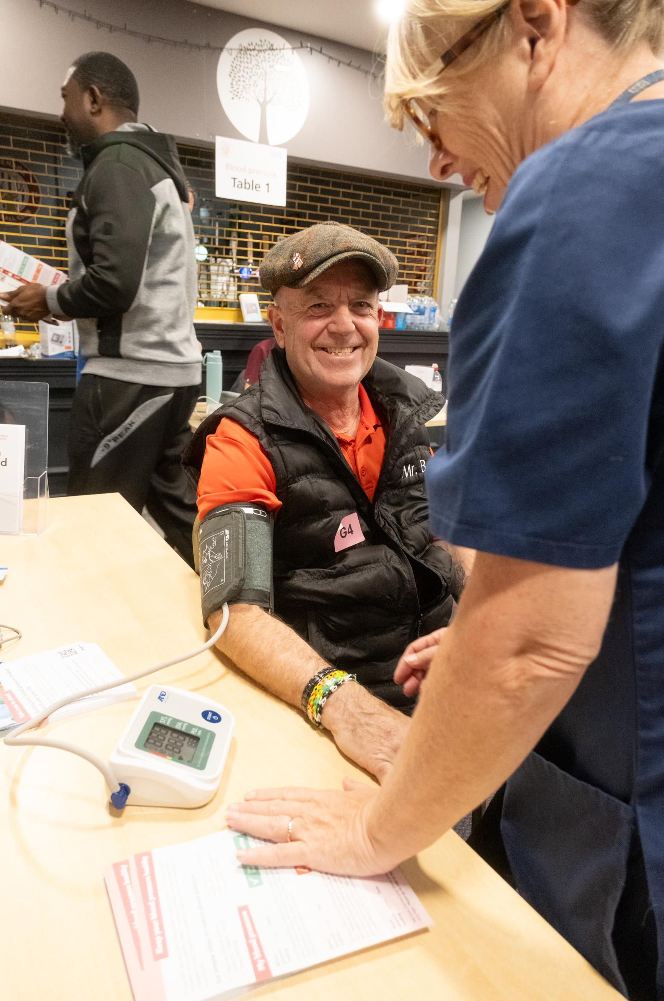

Helping our residents to live healthier lives
179,000 blood pressure checks carried out in community settings in 2024/25.
15,000 people identified as at risk of heart disease or stroke due to high blood pressure received advice and treatment.
Proactive lung cancer screening of 21,000 known smokers and ex-smokers has identified 46 people with lung cancer.
82% of adults in with learning disabilities in our area had their annual health check last year, 7% above the national standard for this vulnerable group.
7294 people on 8 or more repeat medications had a medication review in the 12 months from August 2024, improving treatment and avoiding over-medication, harmful side effects, hospitalisation and addiction.
Notes:
Slide 4 – Prevention
About 450,000 people in our area live with at least one long-term health condition. Many of these conditions. including heart disease, obesity and respiratory illnesses are preventable, with the right targeted interventions and support.
Shifting the focus of the health service to prevention rather than cure has been a big focus for us in the last year. – and that has been echoed in the government’s new 10-Year Plan for the NHS. Partnership working has been the key to our success, and something our teams have lived and breathed over the last few years. Working with NHS, public sector and voluntary and community partners to deliver projects, training and initiatives has improved the outcomes and experiences of older people, children and some of the most vulnerable in our society.
One of the most significant initiatives to have taken place during the last year has been our hypertension or high blood pressure prevention programme. Colleagues have been working across Hertfordshire and west Essex, and particularly in areas where poverty affects health – to deliver blood pressure checks in community and faith settings, supported by trained volunteers through the community champions initiative.
This has increased early detection with 179,000 blood pressure checks carried out in community settings in 2024/25 alone, identifying 15,000 people at risk of heart disease or stroke due to hypertension who have now gone on to receive vital advice and treatment. One man emailed in after one of our events to say: Going to contact my GP tomorrow and get myself sorted. Thanks for saving my life.”
Smoking puts people at increased risk of cancer, dementia, eyesight damage and heart disease. In the last year a targeted lung cancer screening programme identified registered patients at the highest risk of lung cancer in 14 of our Hertfordshire GP practices and those patients were proactively called in for checks to assess their lung health. As a result, 46 people with lung cancer were identified – with 89% identified with early stage lung cancer which would not have exhibited symptoms, who were then started on an urgent treatment pathway.
People living with learning disabilities are much more likely to experience poorer health than the general population, with delayed diagnoses and treatment often leading to lower expectancy. To tackle that, we have worked with GP practices to ensure that annual health groups for adults with learning disabilities are prioritised, and we’re proud that once again, take-up here is well above the national standard.
Multi-agency OPALS - Older Persons Activity, Learning and Safety - events have taken place over the course of the year, supported by our staff. These events aimed to enhance the safety, health and wellbeing of our older residents, reducing their vulnerability, providing reassurance, and combatting loneliness. Through these events we have promoted medication reviews, aimed at supporting patients to understand their treatment options and reduce their risk of falls and other harm side-effects.
These are just some of the many ways in which we’ve used information about patients to carry out targeted health prevention work and help people in our area to stay well.

Slide 5
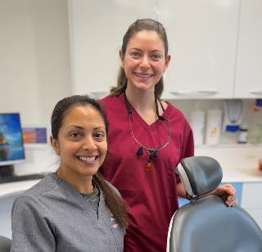


Improving access to local services
98% of all high-street pharmacies provide an improved range of walk-in services, dispensing advice and commonly-used medicines without prescription, through ‘Pharmacy First’.
84% of patients now have online access to their GP records.
8.5 million GP appointments provided in 2024 – up 21% in five years.
73% increase in NHS App usage – putting power into patients’ pockets.
8,422 additional urgent dentist appointments in 2024.
A veteran-friendly accredited GP practice available to patients in all our Primary Care Networks, supporting current and former armed forces staff.
Only 18 children waited for six weeks or more for speech and language assessments in June 2025, a 97% reduction from September 2023.
Mental health outreach teams are now embedded in 50% of our schools.
Notes:
Slide 5 – Primary and Community Care
When people do fall ill and need treatment, the drive to deliver that care closer to home has remained central to the ICB’s strategy, reducing reliance on hospitals and improving and joining up primary and community services.
The community pharmacists in our high streets are more than ever becoming a vital first port of call for many of us when we are ill. Work to progress the ‘Pharmacy First’ service has continued, with access becoming widespread during the last year. By January this year, 98% of all community pharmacies in our area had registered to provide Pharmacy First, ensuring our patients can receive quick and easy care from highly trained pharmacists and medicines to treat seven common conditions without needing a GP appointment: impetigo (aged 1 year and over)
infected insect bites (aged 1 year and over)
earache (aged 1 to 17 years)
sore throat (aged 5 years and over)
sinusitis (aged 12 years and over)
urinary tract infections (UTIs) (women aged 16 to 64 years)
shingles (aged 18 years and over)
We know that timely access to GP services and information is hugely important, and we’ve made big strides here too. The ICB has rolled out cloud-based telephone systems across all GP practices, making it easier to talk to someone without having to hang on the phone, we have enabled online access to records for 84% of patients and driven a 73% increase in NHS App usage – helping people to access test results, information and repeat prescription services without having to go through their GP. Most importantly, our area’s GP practices delivered 8.5 million appointments in 2024 – an increase in 21% since 2019.
Since taking on responsibility for commissioning dental services, we’ve recognised the need to improve access to dentist appointments and put in place a pilot scheme to provide additional urgent dental appointments in Hertfordshire, including at the weekends and on bank holidays. Up to the end of December 2024, the enhanced service provided an additional 8,422 patient appointments.
We recognise the particular support needs of people serving in HM Armed Forces, reservists, veterans and their families. During 2024/25 we met the national target of having at least one veteran friendly accredited GP practice per Primary Care Network (PCN) in our area, ensuring trained support is available when it is needed.​
There has also been vital transformation in commissioning to support children’s mental health, with outreach teams now being placed in almost half of all schools.
We know that the ongoing impact of the COVID pandemic is continuing to impact on waits for services for children and young people, so we have worked with our local authority partners to place mental health outreach teams in half of our schools – improving early access to support, and brought down the number of children waiting for more than six weeks for a speech and language assessment by 97%.

Slide 6

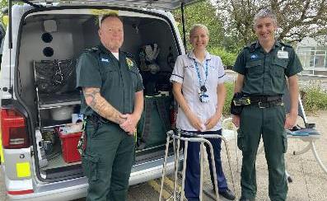
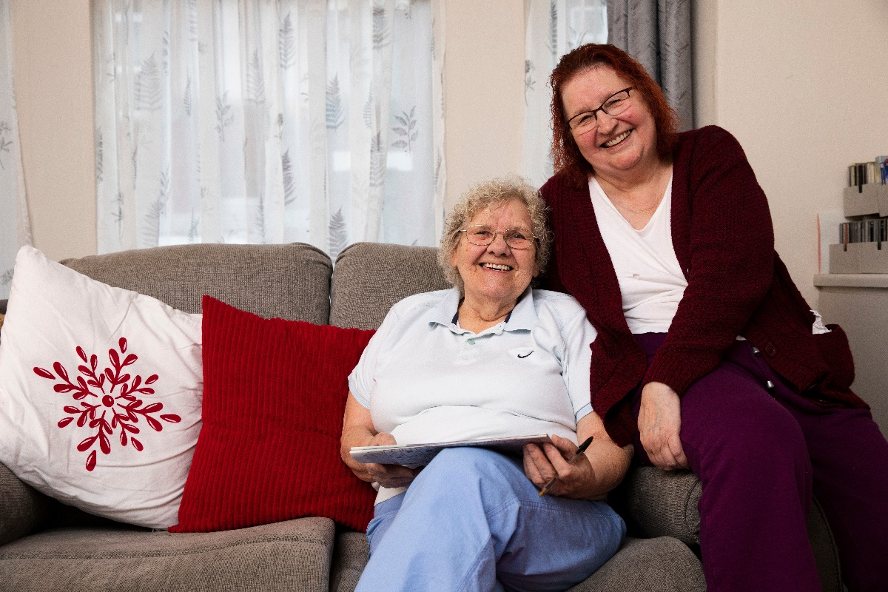
Improving care for older people
400 older people a month avoided hospital admission in our area in March 2025 compared to the average monthly admissions in 2022/23 – a 62% reduction.
Multi-disciplinary teams are expertly helping older people back onto their feet after a fall with clinical and mobility support and home care follow-up, if they need it.
Improved identification of people in their last year of life, with better plans in place to support them according to their wishes in their last days.
More than 12,000 people on the end-of-life register - an increase of 79% from 2022 – with care tailored to recognise this life-stage.
Around four in every five people on the end-of-life register died in a place of their preference in March 2025.
Notes:
Slide 6 – Frailty improvements
More of our population is aged over 85 and under 20, than the national average. We’re seeing the biggest population growth in our older population and our ICB is implementing changes across the full range of health services to support this growing population. From 2018 to 2043, we expect a 73% increase in the number of people aged 85 and over.
There is a big difference between age and ageing and we are helping people to take some control of the ageing process and healthy ageing through better services. We know that being admitted to hospital can have a very detrimental effect on the general health of older people, so we’re working to avoid hospital admission through joined-up community-based care and treatments by integrated neighbourhood teams wherever possible. The results are very compelling.
Overall, there has been a 62% reduction in monthly admissions for people with frailty across Hertfordshire AND West Essex ICB. In March ’25 there were 245 admissions recorded in people with a diagnosis of frailty, compared to an average of 652 emergency admissions per month during the financial year 22/23.
The ‘Falls Car’ – pictured on the screen here at the bottom – has helped to prevent unnecessary hospital admissions for older people who have fallen at home, by checking them out and ensuring that they have both the care and the practical aids to mobility to help them to stay at home safely.
With our help and data analysis, General Practice is improving the way in which people who are in their last year of life are identified, cared for, and supported to choose where they would prefer to spend their last days. There are now more than 12,000 people on the end-of-life register (an increase of 79% from 2022) and the majority of those people have a preferred place of care documented. Around four in every five people on the end-of-life register died outside of hospital in the place they prefer. In comparison, only two in five people died outside of hospital who weren’t identified to get this support.

Slide 7
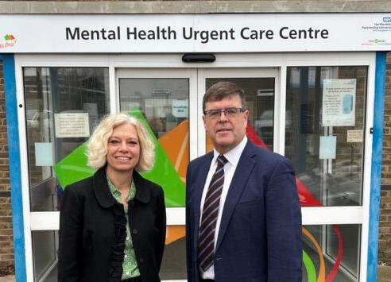
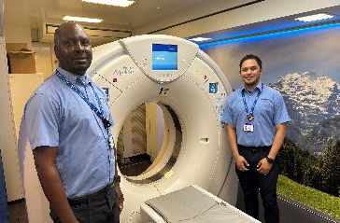
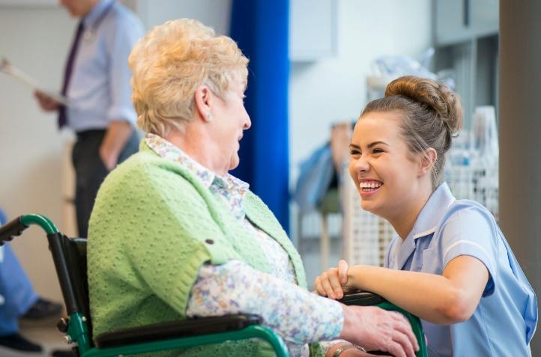
Improved hospital services
59% of all patients referred by to a hospital Consultant in May this year were seen within 18 weeks - the best monthly performance for this metric since Oct 2021.
79.5% of our patients were seen within 4 hours of arriving in A&E in June - the best monthly performance since May 2021.
62-day and faster diagnosis standards for cancer have been met, with 62-day performance finishing on 82% and faster diagnosis standard at 78% at the end of 2024/25 - above the national average.
By the end of the year, all long waits for non-emergency ‘elective care’ had been cleared by WHTHT, with small numbers of patients experiencing long waits at ENHT and PAHT.
Since 2024, hundreds of people in crisis have been cared for in our new Mental Health Urgent Care Centre in Stevenage, rather than busy A&E departments. ​​
Notes:
Slide 7 – hospital services
Of course, hospital treatment and care is entirely appropriate in a number of circumstances and the last year has seen a number of improvements in performance.
Long waits to see specialists have reduced and access to emergency care in our A&E departments and planned care has also seen improvements, supported by the launch of new models of care and pathways.
Across the ICB area, 62-day and Faster Diagnosis standards (FDS) for cancer have been met with 62-day finishing on 82% and FDS 78% respectively at year end (above national averages).
Supporting patients in Mental Health crisis is a key priority of our Medium Term Plan. Since it opened in 2024, 500 people have transferred from emergency departments in the system to the therapeutic environment of our Mental Health Urgent Care Centre in Stevenage – resulting in better care and fewer hospital admissions for people in distress.

Slide 8
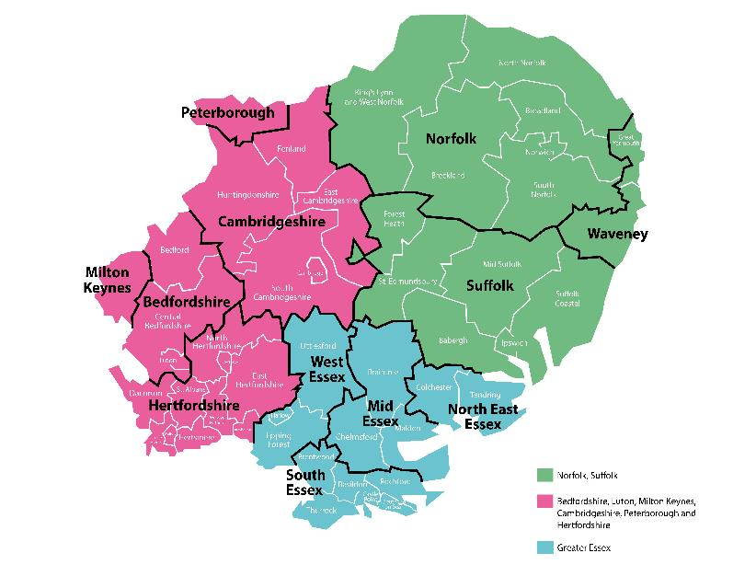
Looking ahead
Three new, larger ICBs will be created:
Central East, incorporating Hertfordshire, Bedfordshire, Luton and Milton Keynes, and Cambridgeshire and Peterborough
Essex, incorporating the current Mid and South Essex ICB area, west Essex and north-east Essex
Norfolk and Suffolk
Rapid rise in over 5s
Unfairness in health
Notes:
Slide 8 – Looking ahead
We are now embarking upon a new chapter, informed by both regional and national change programmes.
New arrangements are coming into place across the East of England, which will create three new ICBs, serving larger populations. The running costs for these new organisations must be significantly lower per head of the population than our current running costs, and some functions which are currently the responsibility of ICBs will transfer to new regional bodies. The number of staff employed by ICBs will reduce overall.
The new ICBs will continue to respond to the 10-Year Health Plan for England, which the government published in July. Local activities will be informed by this plan, which encourages three shifts in approach which are very much in alignment with our ICB’s priorities:
providing care in hospitals to providing care in people’s homes and community settings
moving from ‘analogue’ to digital services, making increased use of joined-up technology to improve outcomes and access for patients and bring efficiencies; and
Investing in preventative services to help people to stay well – a health service, not a sickness service.
The plan also commits to innovation, workforce reform and financial discipline.
As we move forward into this new landscape, work is underway to ensure that appropriate governance is in place with neighbouring systems to sustain delivery and statutory functions.
Local plans will need to be aligned to the new ICB footprints from April 2026 so that accountability and funding flows clearly to the new organisations. This will require the balancing of local needs with broader regional priorities.
Population health management (PHM) will be central to ensuring that health inequalities continue to be tackled with equity across much larger geographies with diverse local needs.

Slide 9
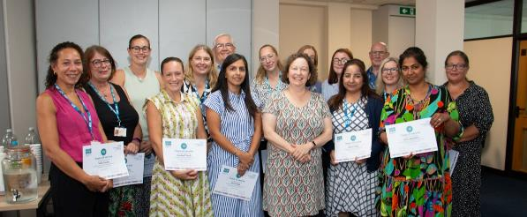
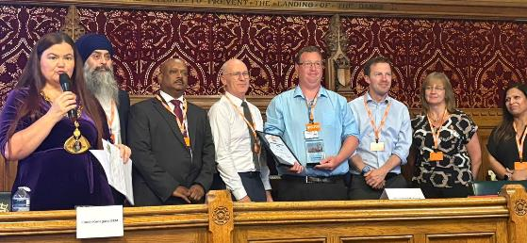

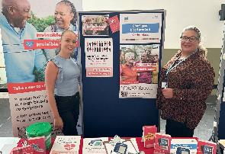
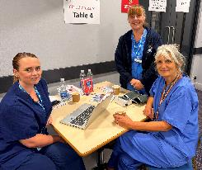
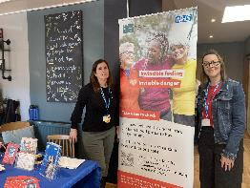
Thank you
Notes:
Slide 9 – Thank you
As we prepare for the changes ahead, I would like to take this opportunity to thank both ICB staff and our system partners in health and social care and the voluntary and community sector for their dedication to improving the health and wellbeing of our population during our time working together.
Every ICB colleague should be incredibly proud of the impact that their work has had – and continues to have – for our communities.
Although we have been managing ongoing budgetary and workforce challenges, the ongoing impact of the COVID pandemic, and periodic industrial action, staff have continued to maintain their focus on delivering on our evidence-based health priorities through meaningful and productive service transformation and change and a sharp focus on quality.
Working in collaboration with our patients, carers, volunteers, partners and stakeholders, we have achieved so much to be proud of. All of these programmes have been delivered in a challenging national context, characterised by ongoing funding constraints, strategic shifts, and workforce pressures.
(Jane to hand back to Jonathan)

Slide 10
Financial update 2024/25
Jonathan Wilson, Chief Finance Officer
Notes:
Slide 10 – Financial update

Slide 11
ICB statutory financial duties
To keep spending within Capital and Revenue Resource Limits
To keep spending within Running Cost Allowance
To not spend more cash than allocated
To achieve value for money in use of resources
To produce Annual Accounts and Annual Report
To keep appropriate accounting records
To increase spending on mental health services by at least the increase in the ICB’s core allocation – the Mental Health Investment Standard
Collective System duty to act with a view to ensuring that the System’s Revenue and Capital Resource limits set by NHS England are not exceeded
Notes:
Slide 11 – statutory duties

Slide 12

2024/25 ICB financial challenge - efficiency savings
Inflation
Population growth
Demography
Service recovery
Other cost pressures
Funding growth lower because of convergence to funding target
Capped Elective Services Recovery
£230m
£135m
Cost growth in HWE ICB exceeds funding growth by £95m. Savings of £102m needed to deliver the planned £6.8m underspend to contribute to overall System financial balance. This equates to 3.1% of total budget. Including Trusts in the System savings of £183m (5.6%) required to achieve financial balance.
Notes:
Side 12 – efficiency savings

Slide 13
Financial challenges in 2024/25
Efficiency savings at 5.6% is the highest value ever levied
Capping for the funding for the recovery of elective services
Inflation remaining high and not fully reflected in the NHS financial settlement
Industrial action impacted on costs and service delivery
Continuing Healthcare increased patient numbers, complexity and cost
Increase in emergency and unplanned demand – including admissions
Significant increase in mental health demand
ICB running cost reduction of 15%
Notes:
Slide 13 – financial challenges

Slide 14
How did we do on our Financial Duties?
Duty | ICB Performance | ICS Performance
Revenue expenditure does not exceed allocations/income | Achieved An underspend of £7.2m | Achieved An underspend of £0.042m
Capital resource use does not exceed resource allocation | Achieved An underspend of £0.2m | Achieved An underspend of £0.15m
Revenue administration expenditure does not exceed allocation | Achieved An underspend of £0.634m | Not applicable
Mental Health Investment Standard | Achieved An increase of 6.82% against a target of 6.67% | Not applicable
Not to spend more cash than allocated | Achieved With a cash balance at 31/3/25 of £0.087m | Not applicable
Better Care Fund minimum contribution increase | Achieved An increase of 5.66% | Not applicable
Notes:
Slide 14 – performance against duties

Slide 15
Where the money was spent in 2024/25
Notes:
Slide 15 - spending

Slide 16
Looking into 2025/26
Low level of funding growth available to meet demand in all areas, Acute, Community, and Mental Health
ICB transition to achieve £19 per head of weighted population for ICB running costs
Population growth, demography and demand continues to grow
Continuation of the capped funding for recovery of Elective Services, whilst improving waiting times.
Continuation of high efficiency levels above 5%, which are required to achieve system financial balance.
Review of the services delivered under Block or Fixed Contract values in Acute, Community, and Mental Health
System still requiring deficit support from NHS England, with the support provided in 2024/25 being reduced by 50%
Significant progress in moving to a balanced plan in 2025/26 has been made, with the financial plan agreed with NHSE having a remaining £15m stretch to achieve breakeven, with performance in line with all other ICS Systems in the East of England
Notes:
Slide 16 – financial forward look.

Slide 17
Thank you
Notes:
Slide 17 – Back to Paul:
Thanks to Jane and the ICB Board
Thank you, Jane and Jonathan for taking us through what has been both an incredibly challenging, and productive year.
As her departure from the ICB approaches, I would like to take this opportunity to extend my thanks to Jane for providing incredible leadership throughout her tenure as CEO.
Jane’s years of experience in the NHS have informed her approach to providing leadership across the system. Her wisdom, steadiness, and strategic vision have been invaluable throughout the journey from CCG to ICB, and more recently, in the vital planning that has gone into forming future regional clusters.
I know that Jane's influence will continue to be felt as we embark on this new chapter in local health and social care delivery.
I would also like to take a moment to thank the Hertfordshire and West Essex Board for the invaluable strategic oversight and direction that they have provided throughout the last year – and in many cases, prior to this.
Their continued support and ability to constructively challenge has been vital to ensuring that we deliver the highest possible standard of services for our local residents.
And finally, thanks must also be given to the many patient representatives, volunteers and carers, who play such a vital role in supporting services across our system. Their tireless advocacy on behalf of their communities and loved ones informs everything that we do as an ICB.
10.30am - close

