Slide 1
ICB Annual General Meeting 2023/24
Dr Jane Halpin, Chief Executive
Rt Hon Paul Burstow, Chair
Alan Pond, Chief Finance Officer
The meeting will begin shortly
Notes:
Slide 1 – Welcome slide

Slide 2
Agenda for today
Welcome …......................... Rt Hon Paul Burstow, Chair
Reflecting on 2023/24 ….... Dr Jane Halpin, Chief Executive
Looking ahead …................ Dr Jane Halpin, Chief Executive
Financial update …............. Alan Pond, Chief Finance Officer
Questions and answers …. At the end of the session
Close …................................ 10.35am
Notes:
Slide 2 – agenda
Welcome everyone, to Hertfordshire and West Essex Integrated Care Board’s Annual General Meeting for the financial year 2023-24.
It’s good to see so many of you here today.
Before we get started, I’m just going to run through some housekeeping.
We will be recording this meeting so those who could not join us today can watch it back. If you do not want to be filmed please do keep your cameras turned off. We will be uploading a copy of these slides to our website in the coming days so you can go back to review them if you wish.
All attendees are currently on mute – this is to help our speakers share the information they need to without background interruptions. We will take you off mute when it comes to question time at the end.
During our AGM today we will hear from ICB Chief Executive Dr Jane Halpin, who will reflect back on the challenges and outcomes of the last year, then a look forward to the priorities for the ICB for 2024/25.
Our Chief Finance Officer, Alan Pond, will talk us through the financial report after which we will have time for questions and answers.
We aim to put aside about 15 minutes for this and will address questions that have come through in advance first, before accepting any questions from the floor.
If you have a questions, please type it into the chat or raise your hand.
Any questions that require an in-depth answer or further research will be taken away and a response provided in writing, so please do leave your email address with our communications team with your question – we will add their contact details to the chat now.
We will try our best to get through as many questions as we can in the time we have available. With that, I’d like to hand over to Dr Jane Halpin.

Slide 3

About Hertfordshire and west Essex
1.6
We plan
and pay for health services
million
people
£3.3
We monitor quality and improve services
billion
budget
Notes:
Slide 3 – About us
Hello, my name is Dr Jane Halpin and it’s my privilege to lead the ICB in its work to improve healthcare in Hertfordshire and west Essex. For those that may not know, here’s a little bit about what we do as an ICB. We use the 3.3 billion pound budget that we are provided from government, to pay for the health services that our population needs. We are also responsible for:
making sure that health services work well and are of high quality
joining up health and care services
improving health and wellbeing
reducing health inequalities
And delivering the integrated care strategy for the area

Slide 4
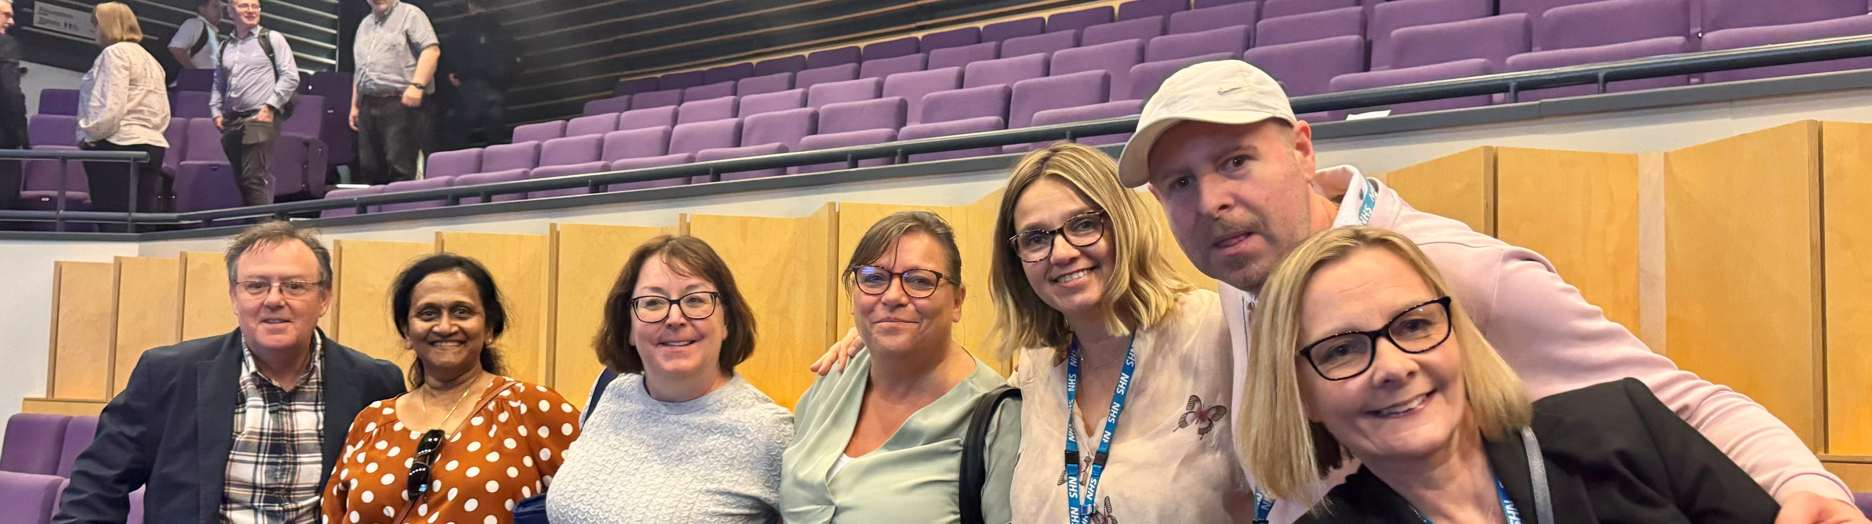
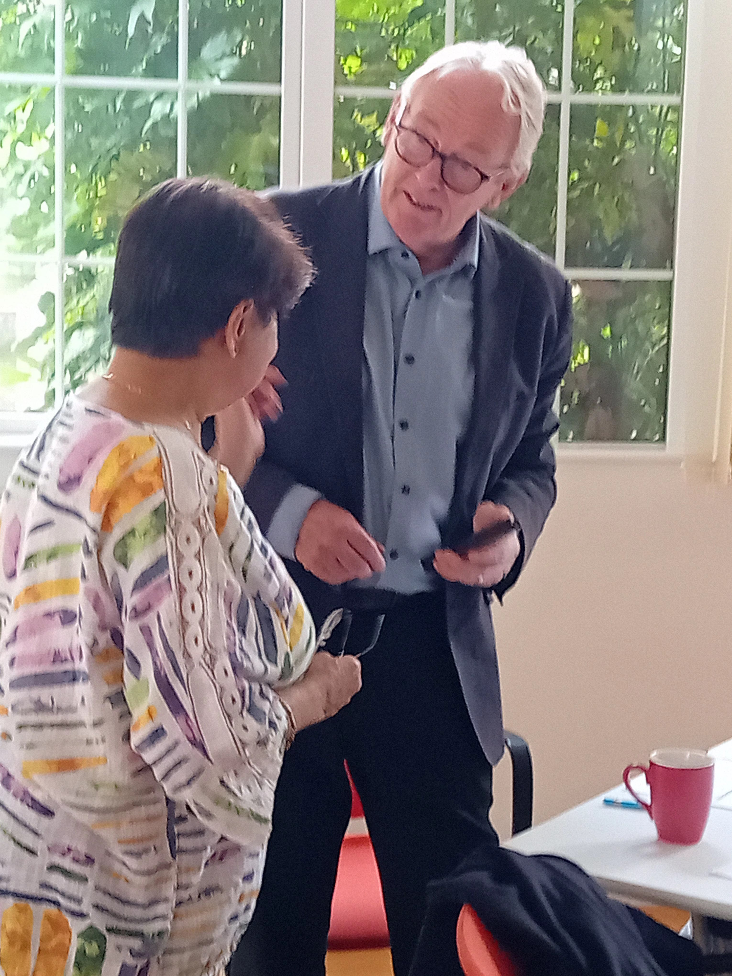

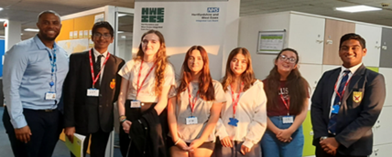

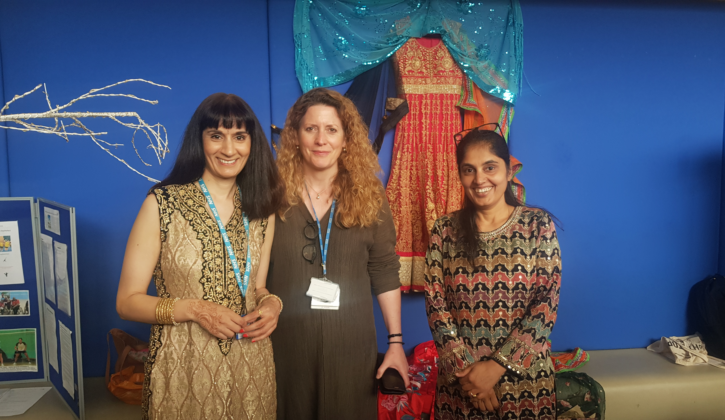
Thank you
Notes:
Slide 3 – Thank you
Before we go further I’d like to recognise that our work in the ICB is made possible because of our staff – and I'd like to thank them for the dedicated work they do every day.
It’s been a challenging couple of years as we've continued to tackle the waiting lists made longer by COVID, settled into working as an ICB, and then were asked to substantially cut our organisational running costs. The work to make efficiencies both within our organisation and across the system is ongoing and the resilience our staff have shown through these difficult times is a testament to their commitment to our patients.
We can’t do what we do without the hard work and commitment of our volunteers and patient groups, including our Youth Council and our Patient Engagement Forum, along with our partners and stakeholders who work with us to deliver services for our population.
Their involvement and our close working relationship with each other illustrates the importance of putting patients and the public at the heart of everything we do.

Slide 5

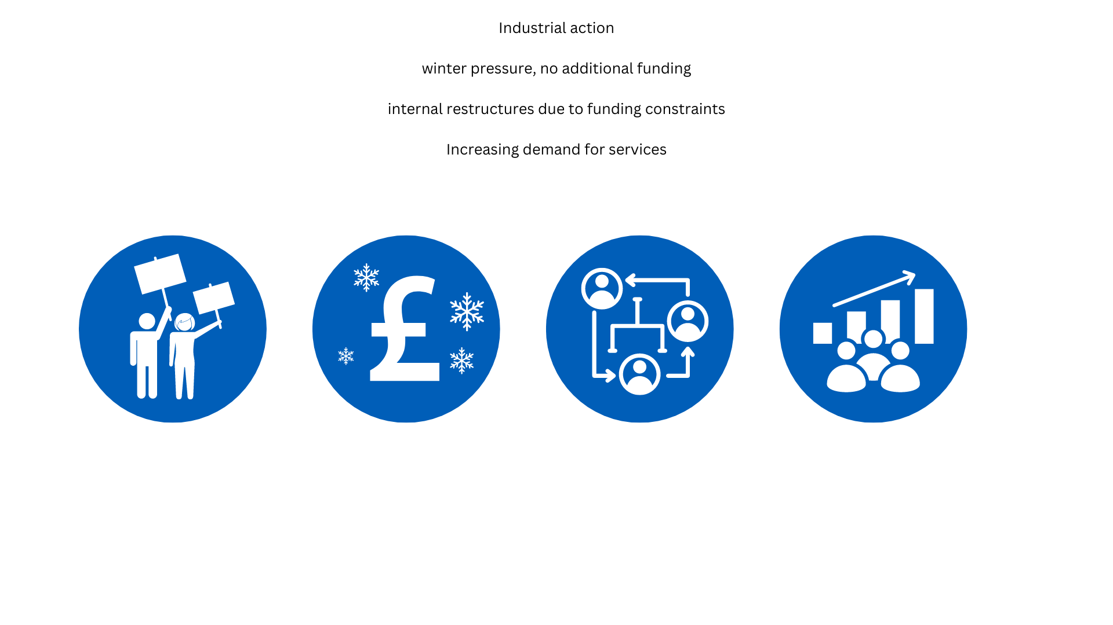
Reflecting on the past year - challenges
Industrial
action
Winter pressures
– no additional funding
Reduced running
cost allowance
Increasing
demand
Notes:
Slide 5 – review of 2023-24 – challenges
Every organisation will face challenges throughout the year – some expected (like winter), some not – like the ongoing industrial action throughout the year.
Despite this, the hard work of our teams has led to a number of positive outcomes, with improved partnership working with our colleagues from across the NHS, local authorities, broader public sector partners and the voluntary sector.
The established and productive relationships we have with our system partners ensure we came together to minimise the impact of the industrial action on our population and workforce.
With winter comes seasonal pressures in the NHS. Our teams worked hard throughout the year to plan for winter, including protecting the most vulnerable through our vaccination programmes. We created more GP appointments to meet demand, which also supported our hospital colleagues at times of pressure within their A&E departments. This is against a backdrop of seasonal illness which increases demand for our services and also impacts on staffing.
I’ve alluded to our funding challenges as an ICB. Just to offer a bit more context we have had a period of restructuring internally due to a national requirement to reduce the operating costs of running ICBs by 30% over two years. We have had to make changes to enable us to work even more efficiently while maintaining our high standards.
We continue to see a rise in demand for many NHS services, including GP appointments, diagnostic tests, outpatient appointments, planned operations, emergency department health, mental health help, and dentistry.
In addition to rising demand, there are various other reasons patients may face difficulties in accessing these services, including staff recruitment and retention, funding issues, and problems with our ageing building and infrastructure. Our teams have faced these challenges head on and are working hard to implement improvements, to address these.

Slide 6

Review of 2023/24
Notes:
Slide 6 – Review of 2023-24 (images only on automatic slideshow)
Despite the challenges there are very many things we’re proud of this year, including the relaunch of the Integrated Urgent Assessment and Treatment Centre at Princess Alexandra Hospital in Harlow, which provides urgent care to those referred by the hospital’s Emergency department and NHS 111. Across our area, we’re also seeing the further development of Integrated Neighbourhood Teams which bring staff together in a way that offers vital services to our residents and supports people to be looked after in their own homes.
Here are just a few more of our achievements from the last year.
Through focused work and campaigning we are helping our residents to diagnose and treat their high blood pressure, protecting them from serious health risks.
The targeted lung health checks programme is picking up early signs of lung cancer in patients who have a history of smoking
Our Patient Engagement Forum is advising our Board.
We have opened a new mental health urgent care centre at Lister Hospital
Work has started on the elective St Albans Surgical Hub
We have further strengthened our partnership with the University of Hertfordshire has grown and we are supporting its medical school
We have increased children’s mental health access by 44% year-on-year
Our ICB is in the top 10 in the country for referring people into the national digital weight management programme
We’ve completed a governance review that has started the shift in decision making to our health and care partnerships
There were remarkable improvements to waiting times in the accident and emergency department of West Herts Teaching Hospitals NHS Trust. The trust was ranked as seventh best according to NHS England figures in July, with 83% of their patients arriving at A&E being seen within the four-hour target time.
We established, with partners, a Quality Improvement Network to understand how system-wide issues can be tackled, understand what can be achieved when organisations work together, and drive improvement activity across the system.
We’ve achieved all this and more and kept our system spending to agreed budgets last year, despite significant demands on it.

Slide 7

Review of 2023/24
Now commission pharmacy, optometry and dentistry
Protecting vulnerable people with vaccines
New mental health urgent care centre at Lister Hospital
Strengthened and expanded ‘Hospital at Home’ care
Helping patients get the GP appointments they need with the most appropriate clinician
Reduced the time people have to wait for treatment after being referred
Notes:
Slide 7 – Review of 2023-24
As I mentioned earlier, some patients struggle to access primary care services – whether that is to see GP practice staff or dentists.
Responding to this, the ICB commissioned dental colleagues to open up more appointments in 2023-24 which we are extending into 2024-25. This will help to ensure that people who do not usually receive dental treatment, can do so more easily.
We’ve also opened up urgent access to dental appointments and have been running a pilot scheme since December 2023 to provide urgent appointments during the day, evenings and weekends to patients who are referred via NHS111.
In general practice we have helped provide nearly 4% more GP appointments, compared with the year before. Patients can see a more varied range of clinical and non-clinical professionals in our GP practices. Many practices offer appointments with physiotherapists, mental health practitioners, social prescribers and health and wellbeing coaches. This ensures patients are able to see the right person for their needs and ensures that GP time is able to support those patients who most need their expertise.
In January 2024, the new mental health urgent care centre at the Lister Hospital in Stevenage opened to support people in crisis, not just in Stevenage but across a wider area. Offering expert mental health help in a calm environment, the centre is helping people in crisis, offering them community support and reducing avoidable hospital admissions.​ We have also been successful in reducing the need to place patients requiring inpatient services outside our area when they need inpatient care although this remains a challenge.
In cancer care we are maintaining a consistently strong performance on cancer treatment – we were the only health system in the East of England where all three of our acute hospital trusts met the Faster Diagnostic Standard for cancer in March 24.
More broadly, our focus on care closer to home has seen our Hospital at Home services support more patients to be monitored by clinicians from their own home. This enables patients to return home where clinically appropriate and frees up beds for patients who need to be in hospital. And also helping patients avoid admission where it is possible to support them in a different way instead. NHS England said in our annual assessment letter that: “The ICB has been at the forefront of developing virtual wards across the region”.

Slide 8




Looking ahead – challenges for our population
Rapid rise in over 85s
Unfairness
in health
Wrong care wrong place
Financial deficit
Notes:
Slide 8 – Looking ahead
The population of Hertfordshire and west Essex is generally healthier and lives longer than the national average. The number of years people will live before encountering significant illness, is 64.5 years for men and 65.7 years for women. Total average life expectancy is 81 and 84 years respectively. However we recognise considerable variation within and between our communities – in some areas life expectancy is relatively low, with people struggling to live with the health and wellbeing impacts brought by economic deprivation.
Our Population Health Management Team provides us with essential data around this that informs our work. We know that the number of over 85 year olds in our population is expected to rise by 55% in the next 15 years. And while this is a brilliant thing to celebrate with increasing life expectancy, we know his will bring additional demands to health and care service as we know this age group is also the biggest user of health and care services. We're using the detailed information we have about the health of our communities to inform the care and services we offer to our patients.
Good patient experience means working towards getting patients the right care in the right place at the right time. Not doing so can inadvertently lead to greater dependency and reliance on healthcare and loss of confidence in the ability to manage for one’s self and one’s own care. We aim to offer proactive, integrated care and to support people with the knowledge and help they need to prioritise and manage their own health and wellbeing wherever possible.
As we move into a new financial year we have already put in place a plan to focus on specific priorities to support our residents to live healthier lives for longer.

Slide 9


Ambitions in our Medium Term Plan
Priority two: Improve urgent and emergency care (UEC) through more anticipatory/same day emergency care (SDEC)
Reduce inequality with a focus on outcomes for heart disease
Improve urgent and emergency care
Better care for those in mental health crisis
Elective
care
recovery
Reducing the backlog in children’s care
Notes:
Slide 9 – Priorities in our Medium Term Plan
Our Medium Term Plan, which take us through to 2029/2030, sets out how we intend to deliver our ambitions while making the efficiency savings needed to reduce the rate of health services expenditure in our system and become financially sustainable. Between now and 2026 we will focus on delivering the priorities shown here.
We’ve talked through some of the programmes of work that are already starting to make a difference.
In the year to come, a new community diagnostic centre at St Margaret’s Hospital in Epping, a new centre for planned surgery in St Albans and extended diagnostic testing in Bishop's Stortford are just three of the projects which will support some of these ambitions.
On a larger scale, we await with great interest the current review of the New Hospital Programme, which is so important for future acute hospital services in Watford and Harlow, two of our three hospitals which are in principle scheduled to be fully re-provided as well as the public consultation due to start shortly into the Mount Vernon Cancer Centre used by our residents, currently based in Northwood in facilities which date from the early part of the previous century.
That was just a whistlestop tour of our ambitions and plans for the year ahead. I hope you have found that useful and it has given you an understanding of our direction of travel for this financial year.

Slide 10
Financial update
2023/24
Alan Pond, Chief Finance Officer

Slide 11
ICB statutory financial duties
To keep spending within capital and revenue resource limits
To keep spending within running cost allowance
To not spend more cash than allocated
To achieve value for money in use of resources
To produce annual accounts and annual report
To keep appropriate accounting records
To increase spending on mental health services by at least the increase in the ICB’s core allocation – the Mental Health Investment Standard
Collective system duty to act with a view to ensuring that the system’s revenue and capital resource use limits set by NHS England are not exceeded

Slide 12

2023/24 ICB financial challenge - efficiency savings
£184m
Funding growth
lower because of convergance to funding target
Elective Recovery Funding
Inflation
Population growth
Demography
Service recovery
Other cost pressures
£236m
Cost growth in HWE ICB exceeds funding growth by £52m.
Savings of £61m needed to deliver the planned £9.4m underspend to contribute to overall system financial balance. This equates to 1.9% of total budget. Including Trusts in the system savings of £147m (4.5%) required to achieve financial balance.

Slide 13
Financial challenges in 2023/24
Efficiency savings at 4.5% higher than previously achieved in memory
Inflation very high and not fully reflected in the NHS financial settlement
Industrial action impacted on costs and service delivery
Continuing Healthcare: increased patient numbers, complexity and cost
Increase in emergency/unplanned demand – including admissions
Significant increase in mental health demand – including admissions
Increase in agency staff usage in Trusts
ICB running cost reduction of 20%

Slide 14

How did we do on our Financial Duties?
Duty | ICB Performance | ICS Performance
Revenue expenditure does not exceed allocations/income | Achieved An underspend of £13.998m | Achieved An underspend of £0.038m
Capital resource use does not exceed resource allocation | Achieved An underspend of £0.121m | Achieved An underspend of £0.6m
Revenue administration expenditure does not exceed allocation | Achieved An underspend of £1.539m | Not applicable
Mental Health Investment Standard | Achieved An increase of 9.29% against a target of 9.01% | Not applicable
Not to spend more cash than allocated | Achieved With a cash balance at 31/3/24 of £0.946m | Not applicable
Better Care Fund minimum contribution increase | Achieved An increase of 5.66% | Not applicable

Slide 15
Where the money was spent in 2023/24

Slide 16
Looking into 2024/25
Less funding growth in 2024/25
compared to 2023/24
Low level of funding growth available to meet Urgent and Emergency Care demand
Further 10% reduction in ICB running cost allocation
Population growth, demography and demand continues to grow
Commissioning of services from NHS Trusts on a negotiated contractual basis under Aligned Payment Incentive Agreements
Elective Recovery Fund provides financial support and incentive to increase elective activity – but funds are not guaranteed
System Development Funding continues to provide targeted funding – most going into mental health, primary care and community services
Even higher level of efficiency savings needed at 5.1%
Even at this level financial plan agreed with NHSE still has a deficit of £20m (like 31 out of 42 ICSs)

Slide 17
Questions
Notes:
Slide - Questions
Thank you, Jane and thank you Alan for taking us through what has been a full but productive year.
We will now open the floor to questions. You can type your question it into the chat or raise your hand. Any questions we can get to before the close of the meeting that require an in-depth answer or further research will be taken away and a response provided in writing, so please do leave your email address with our communications team with your question – we will add their contact details to the chat now.
We will start the question session with a question that was submitted to us in advance of this meeting. The question asked: “How does one access one’s GP? In Epping Forest, The Limes Practice, is a nightmare to get through, then impossible to see or speak with a GP. This has been an issue for long time now and nothing seems to improve. No one is held to account for the very poor service. I feel that the service deteriorated especially after establishment of Steller Healthcare. Have they taken their eye off the ball to concentrate on Steller Healthcare? Would be interested to know if this was done for financial reasons.”

Slide 18
Thank you

